Slide 1
70-533 : Implementing Microsoft Azure Infrastructure Solutions

Slide 2
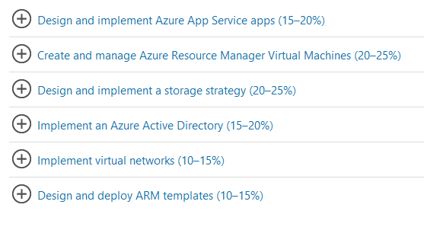
70-533 : Implementing Microsoft Azure Infrastructure Solutions

Slide 3
Configure Cloud Services

Slide 4
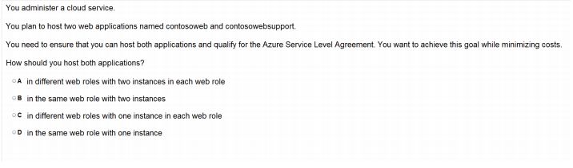
Ans – B What to Explain Explain Cloud Service and Web Roles

Slide 5
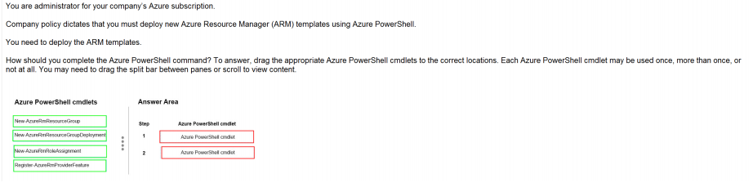
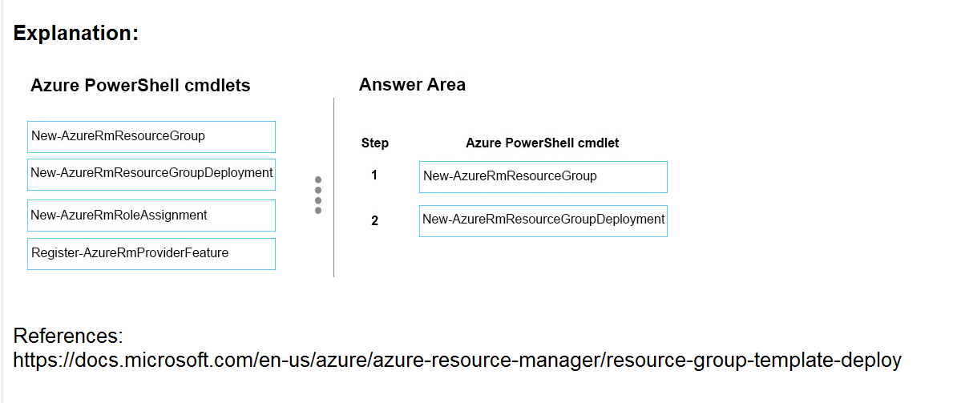
Ans =

Slide 6
Description
The New-AzureRmResourceGroup cmdlet creates an Azure resource group. You can create a resource group by using just a name and location, and then use the New-AzureRmResource cmdlet to create resources to add to the resource group. To add a deployment to an existing resource group, use the New-AzureRmResourceGroupDeployment cmdlet.
To add a resource to an existing resource group, use the New-AzureRmResource cmdlet. An Azure resource is a user-managed Azure entity, such as a database server, database, or website. An Azure resource group is a collection of Azure resources that are deployed as a unit.

Slide 7
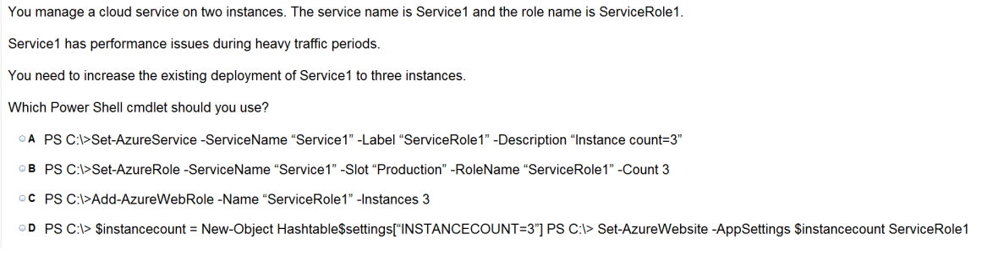
Ans = B

Slide 8
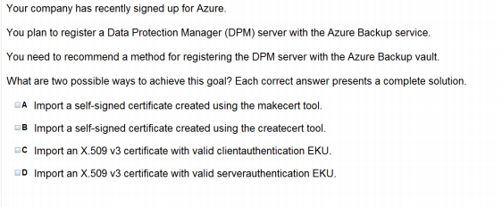
Ans = A & C

Slide 9
Deploy and manage Cloud Services

Slide 10
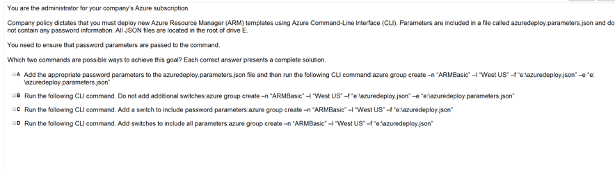
Ans = B & D

Slide 11
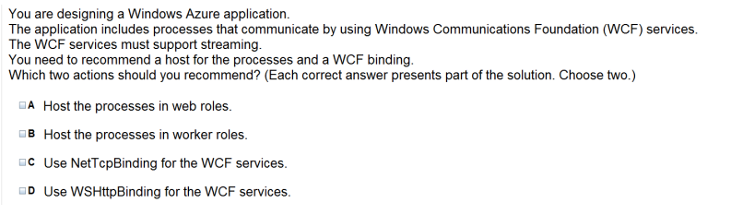
Ans = B & C

Slide 12
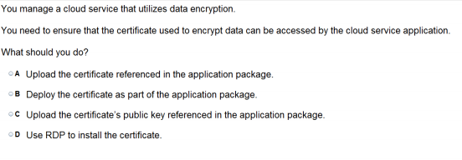
Ans – A

Slide 13
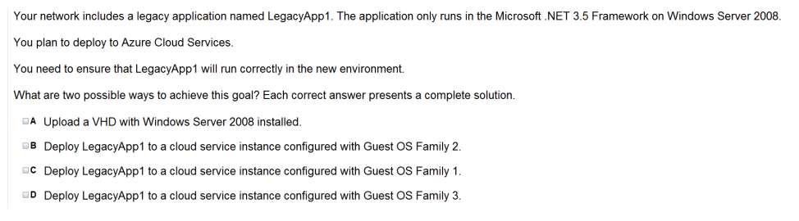
Ans = A & B Family 2 releases Windows Server 2008 R2 SP1 Family 3 releases Windows Server 2012 Family 4 releases Windows Server 2012 R2

Slide 14
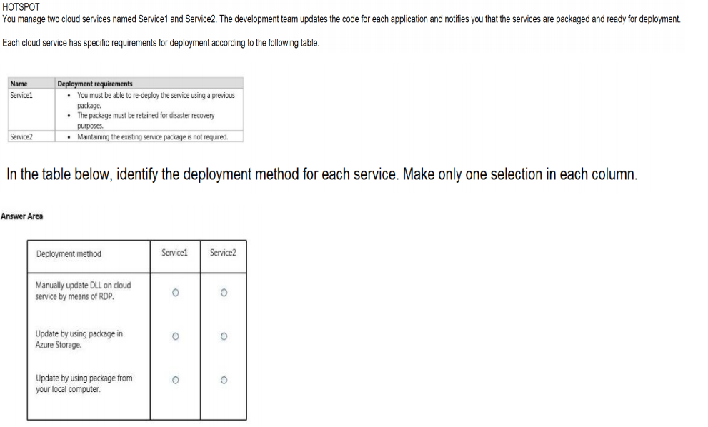
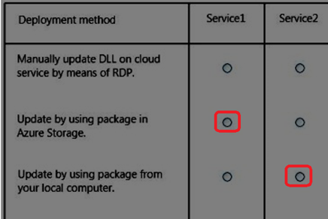
Ans =

Slide 15
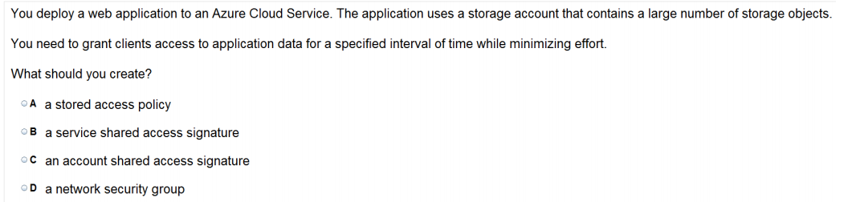
Ans =C

Slide 16
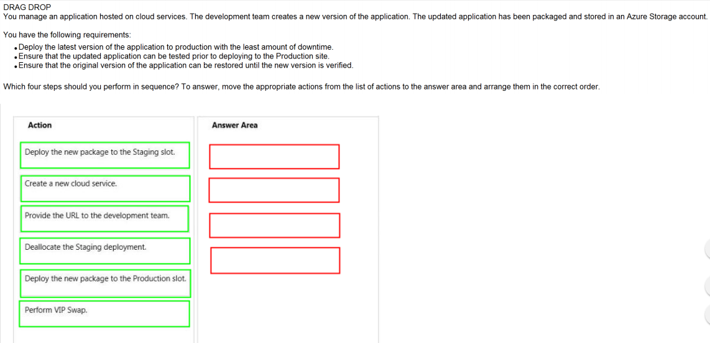
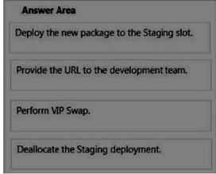
Ans =

Slide 17
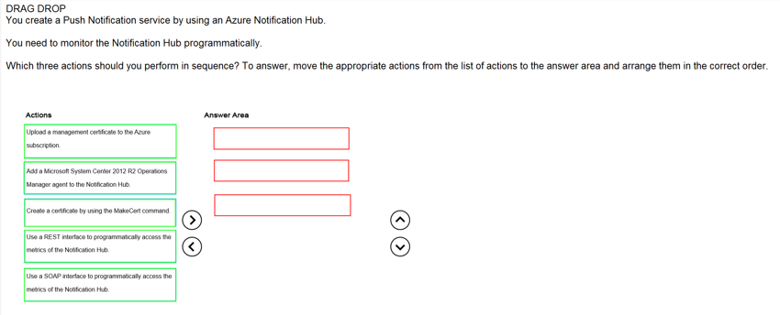
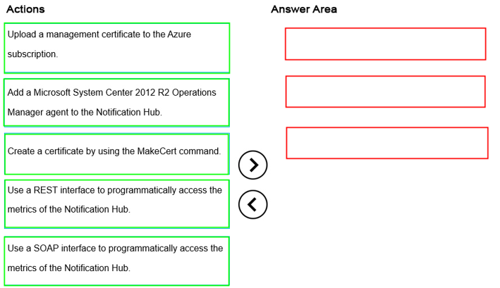
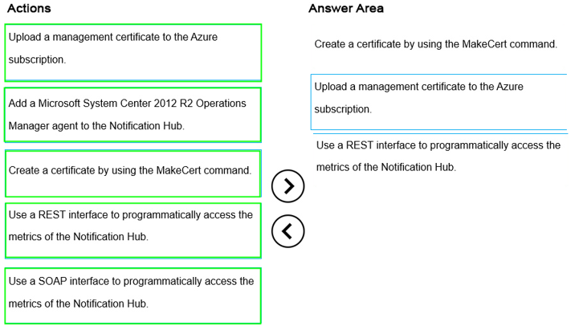
Ans =

Slide 18
Monitor Cloud Service

Slide 19
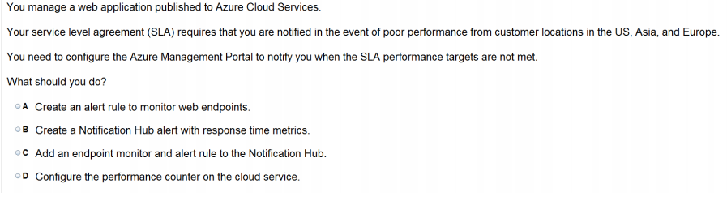
Ans = A

Slide 20
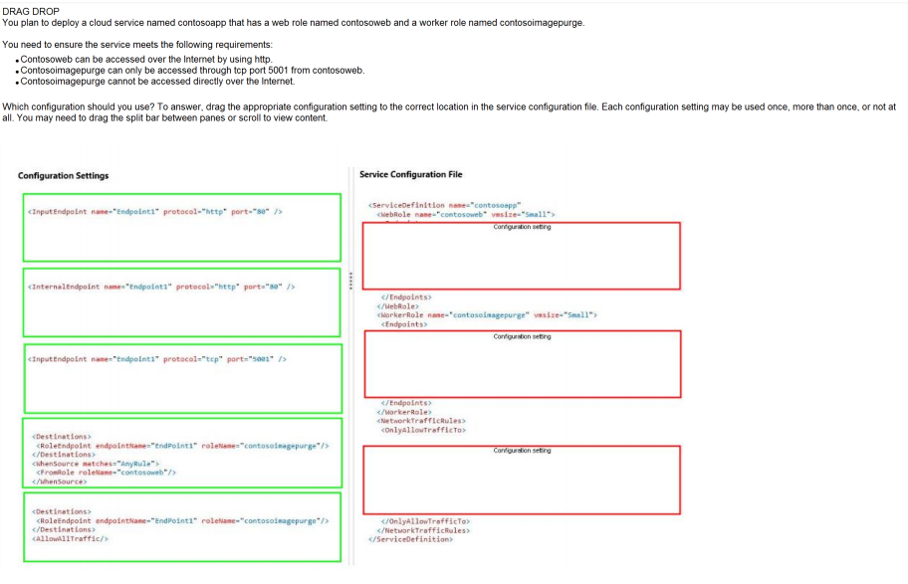
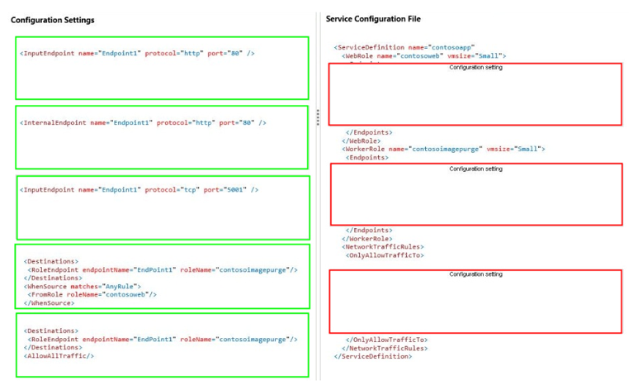
Ans =

Slide 21
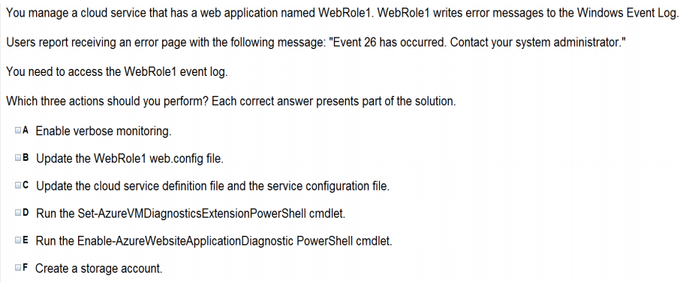
Ans = A & C & F

Slide 22
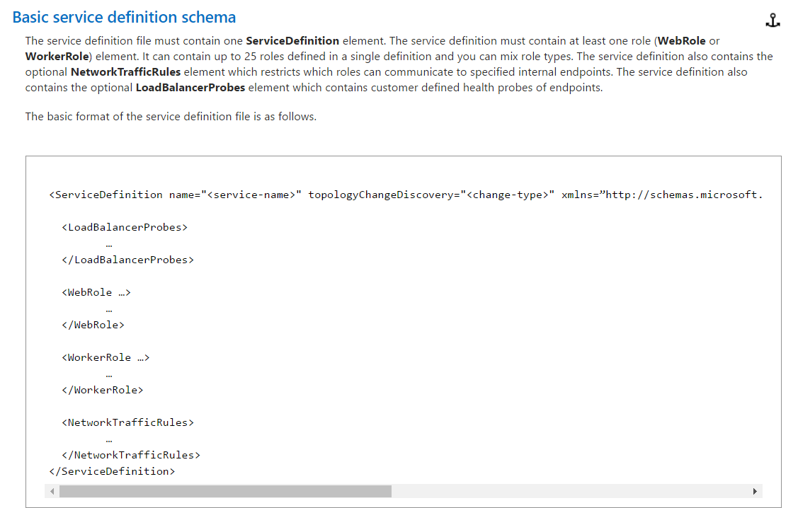
The service definition file defines the service model for an application. The file contains the definitions for the roles that are available to a cloud service, specifies the service endpoints, and establishes configuration settings for the service.

Slide 23
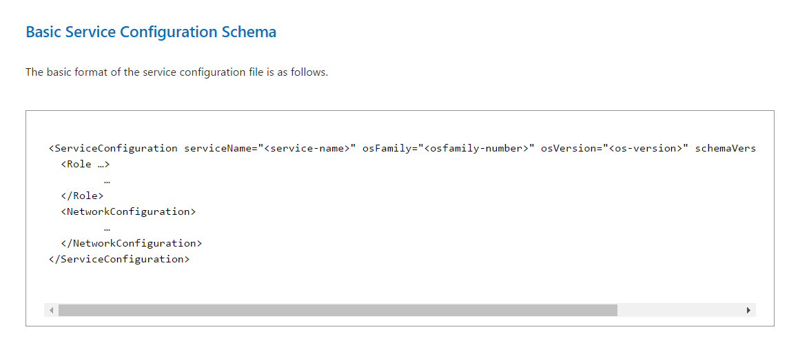
The service configuration file specifies the number of role instances to deploy for each role in the service, the values of any configuration settings, and the thumbprints for any certificates associated with a role. If the service is part of a Virtual Network, configuration information for the network must be provided in the service configuration file, as well as in the virtual networking configuration file.

Slide 24
Azure Service Bus

Slide 25
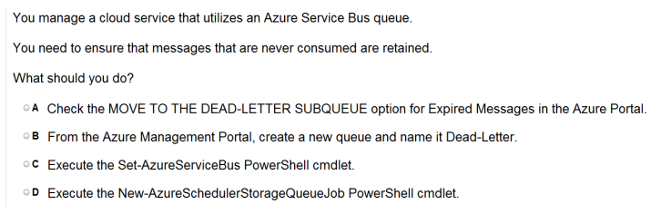
Ans =A

Slide 26
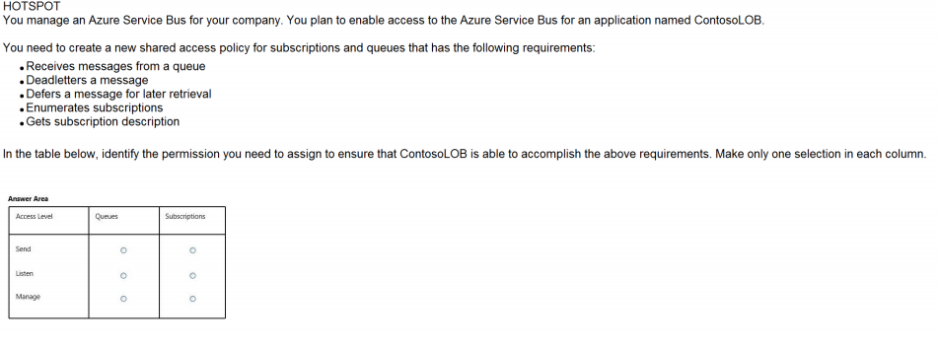
Ans – Queue – Listen Subscriptions - Manage

Slide 27
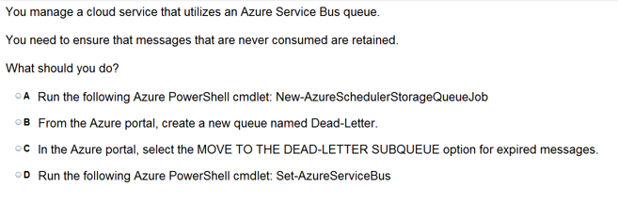
Ans =C

Slide 28
Azure Back up

Slide 29
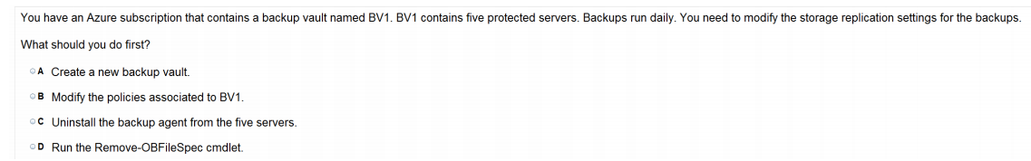
Ans =B
Azure Backup is the Azure-based service you can use to back up (or protect) and restore your data in the Microsoft cloud. Azure Backup replaces your existing on-premises or off-site backup solution with a cloud-based solution that is reliable, secure, and cost-competitive.
Azure Backup offers multiple components that you download and deploy on the appropriate computer, server, or in the cloud. The component, or agent, that you deploy depends on what you want to protect. All Azure Backup components (no matter whether you're protecting data on-premises or in the cloud) can be used to back up data to a Backup vault in Azure.

Slide 30
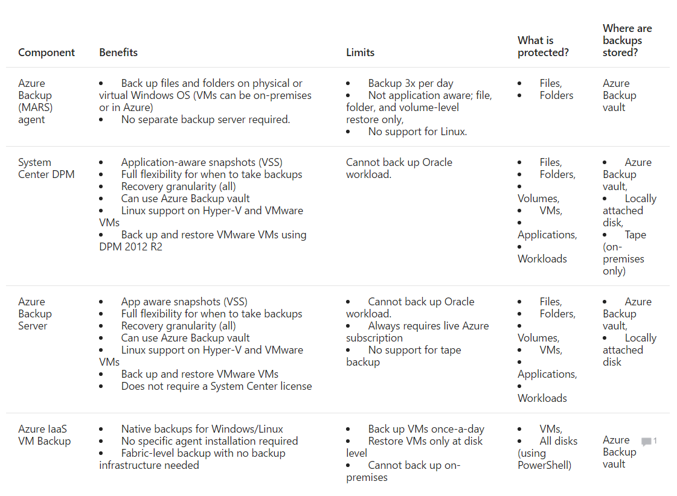

Slide 31
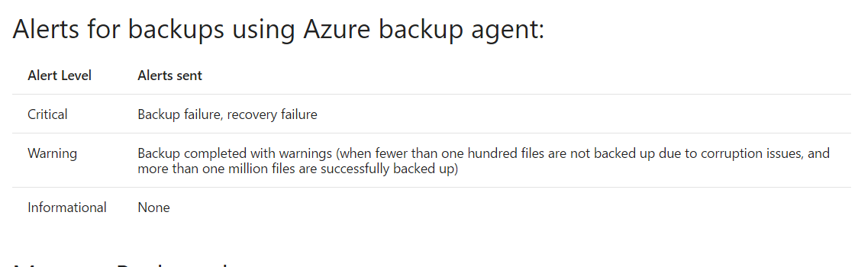

Slide 32
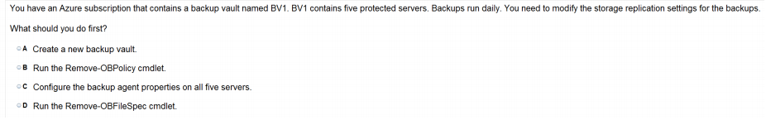
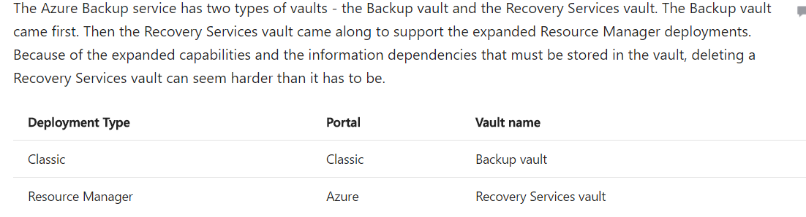
Ans = C

Slide 33
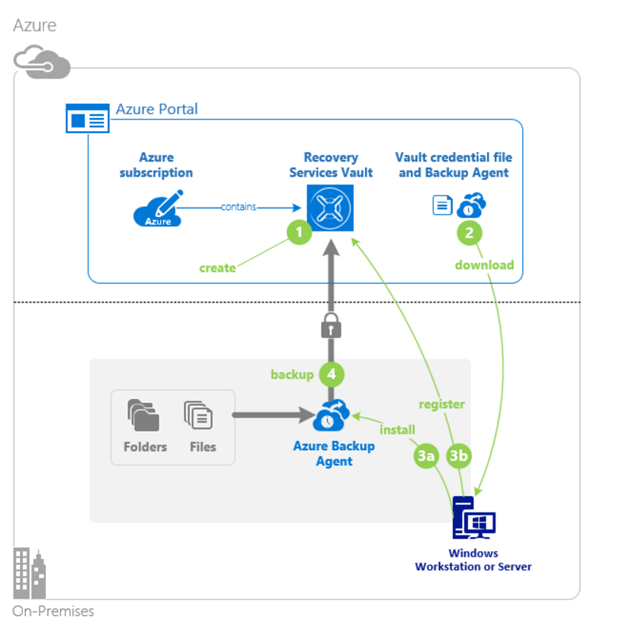
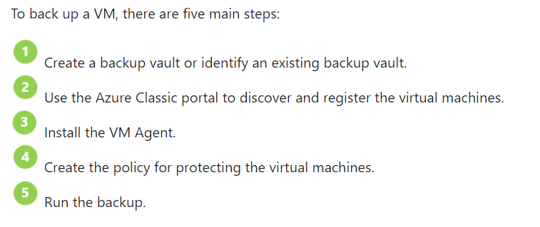

Slide 34
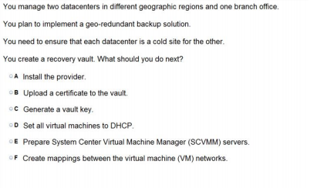
Ans – C

Slide 35
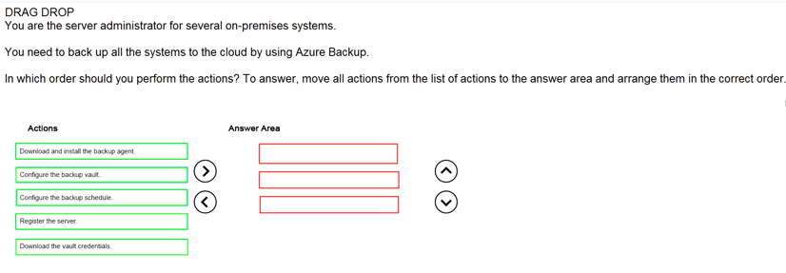
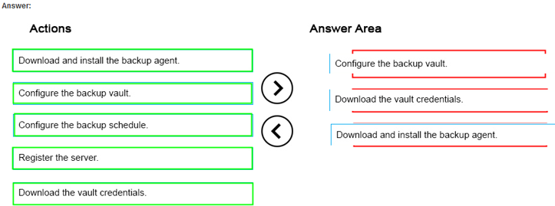
Ans =

